Slide 1
Introduction to Data Science Data Mining for Business Analytics
Brian d’Alessandro
VP – Data Science, Dstillery
Adjunct Professor, NYU
Fall 2014
Fine Print: these slides are, and always will be a work in progress. The material presented herein is original, inspired, or borrowed from others’ worl. Where possible, attribution and acknowledgement will be made to content’s original source. Do not distribute, except for as needed as a pedagogical tool in the subject of Data Science.
Notes:
https://www.youtube.com/watch?v=aMDe5pODkB0 (harlan harris)

Slide 2
The Data Science Environment

Slide 3
So you’ve got yourself a DS job
Things to consider in the wild….
Who will I work for?
What programming languages will I use?
What infrastructure will I use?
Notes:
Show photos of stats and pandas

Slide 4
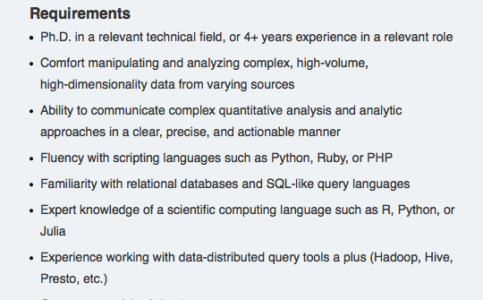
The resume: skills
Through the lens of a FB Data Scientist Job Description
PhD not necessary, but experience is
Notes:
Show photos of stats and pandas

Slide 5
The resume: skills
Through the lens of a FB Data Scientist Job Description
You can’t be a Data Scientist if you can’t handle data…
Notes:
Show photos of stats and pandas

Slide 6
The resume: skills
Through the lens of a FB Data Scientist Job Description
This is essentially the goal of this course.
Notes:
Show photos of stats and pandas

Slide 7
The hard skills
Through the lens of a FB Data Scientist Job Description
Necessary: a scripting language, SQL and a scientific computing language
Notes:
Show photos of stats and pandas

Slide 8
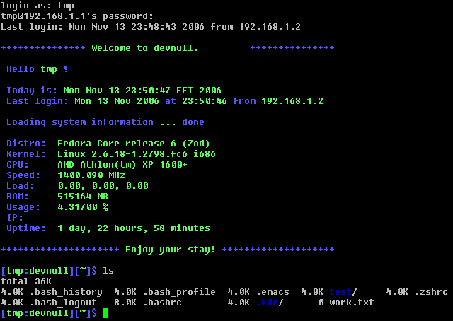
Developing for ds
LEARN LINUX!
This is not going to be a focus of the course, but almost every engineering and DS team uses it.
Notes:
Show photos of stats and pandas

Slide 9

Developing for ds: Version control
LEARN GIT!
In this course we will suggest using Github
Notes:
Show photos of stats and pandas

Slide 10
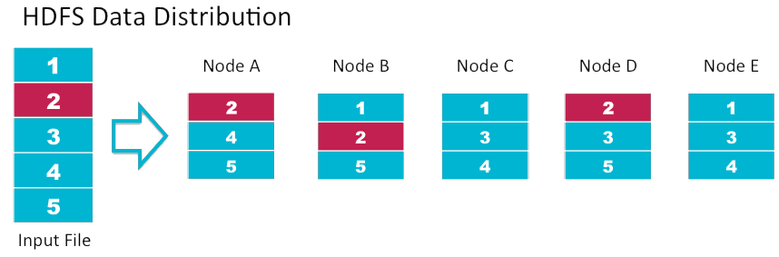



big data storage: Hdfs
HDFS: Distributed and redundant file storage system. Distribution speeds up computation and redundancy improves fault tolerance.
People access and analyze data on hdfs using:
Notes:
Show photos of stats and pandas

Slide 11



big data storage: Nosql
There is a big movement towards schema free databases that scale very well.
Notes:
Show photos of stats and pandas

Slide 12
Just as there is no concise definition of a data scientist… There is no single ds working environment

Slide 13
2 ways to organize (1/2)
The centralized team
Someone Important
Head of Data Science
Sales & Marketing
Head of Data Science
Engineering
Operations
Data
Scientist
Data
Scientist
Notes:
Show photos of stats and pandas

Slide 14
2 ways to organize (2/2)
The embedded team
Someone Important
Sales & Marketing
Head of
Engineering
Operations
Data
Scientist
Team Lead 1
Engineers
Data
Scientist
Team Lead 2
Engineers
Notes:
Show photos of stats and pandas

Slide 15
Which is better
Bottom line: every situation is different, though hybrid models (like rotational embedding) can achieve best of both worlds.
 | Pros | Cons
Centralized | Variety of problem exposure | Disconnect w/ Product Details
 | Develop own Standards | Standards not in Sync with Engineers
 | Like minded peers | Limited exposure to Engineering work
Embedded | Deeply integrated with implementation | Limited variety of problems worked on
 | More exposure to hard tech skills | Risk of being a pure engineer
Notes:
Show photos of stats and pandas

Slide 16
summary
Knowing what to expect when you hit the job market can shape your course of study.
Required Skills
Bonus Skills
Linux
Python (safest bet)
SQL
Good communication
Hdfs
Hadoop/Hive/Pig
NoSQL
Java/C++
Version Control
Notes:
Show photos of stats and pandas

